Slide 1
Disease Prediction Using Machine Learning

Slide 2
Agenda
Executive Summary
Introduction
Approach
Methodology
Results
Discussion
Recommendations
Conclusion

Slide 3
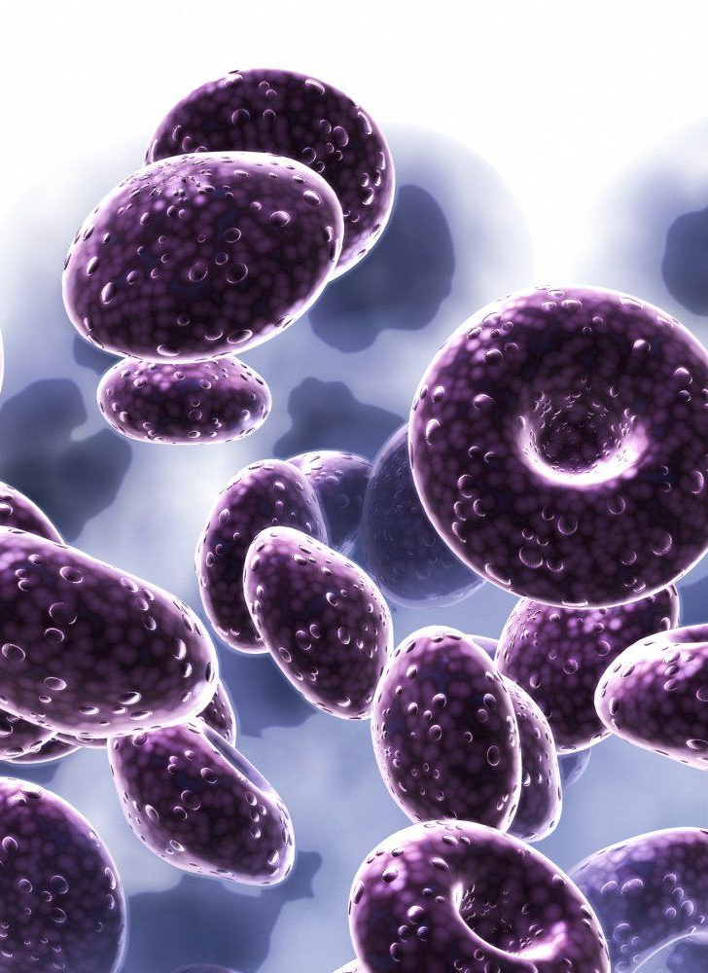
Executive Summary or Abstract The executive summary provides a concise overview of the entire project, summarizing its objectives, methodology, key findings, and recommendations. It highlights the significance of disease prediction using machine learning techniques and outlines the main contributions of the project.

Slide 4
This project discusses the importance of early disease detection , the role of machine learning in healthcare, and the motivation behind the project. It also outlines the objectives and scope of the study.
Introduction

Slide 5
Approach
TOOLS:
Python, Scikit-Learn, Pandas, NumPy, Matplotlib, Seaborn, Jupyter notebook, Git.
TECHNIQUES:
Machine Learning Algorithms, Data Manipulation, Data Visualization, Model Deployment, Code Documentation.

Slide 6
Methodology:
Accuracy: To measure the overall correctness of disease predictions made by the model.
Precision: To assess the proportion of true positive predictions among all positive predictions made by the model.
Recall: To evaluate the ability of the model to correctly identify all relevant instances of diseases.
F1-score: To combine precision and recall metrics to provide a balanced evaluation of the model's performance.
Cross-Validation: To ensure the model's generalization ability by validating its performance on multiple subsets of the dataset.

Slide 7
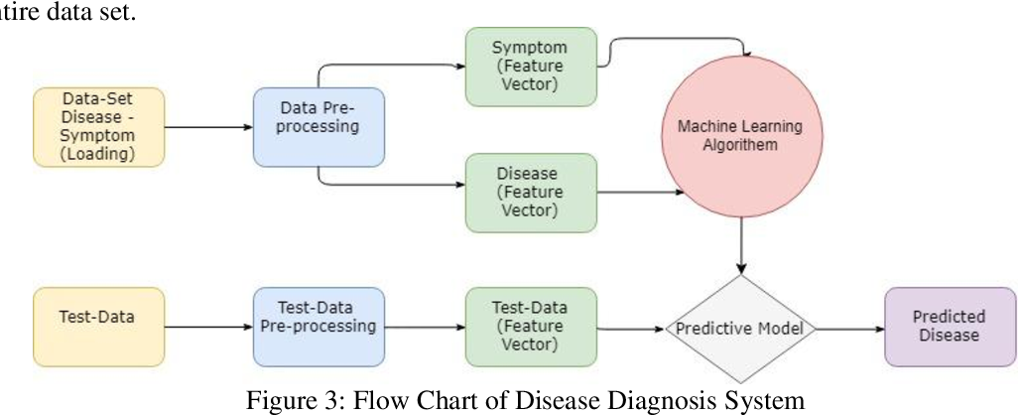

Slide 8
Data Collection: Gather a comprehensive dataset comprising various patient attributes such as age, gender, medical history, symptoms, and diagnostic test results.
Data Preprocessing: Cleanse and preprocess the dataset to handle missing values, outliers, and ensure uniformity in data formats.
Feature Selection: Identify relevant features that contribute significantly to disease prediction while minimizing dimensionality.
Model Selection: Experiment with different machine learning algorithms such as logistic regression, decision trees, random forests, support vector machines (SVM), and neural networks to determine the most suitable model for disease prediction.
Model Training: Train the selected machine learning model on the preprocessed dataset, optimizing hyperparameters to improve performance.
Model Evaluation: Assess the performance of the trained model using evaluation metrics such as accuracy, precision, recall, and F1-score.
Deployment: Deploy the trained model in a user-friendly interface for healthcare professionals to input patient data and obtain disease predictions in real-time.

Slide 9
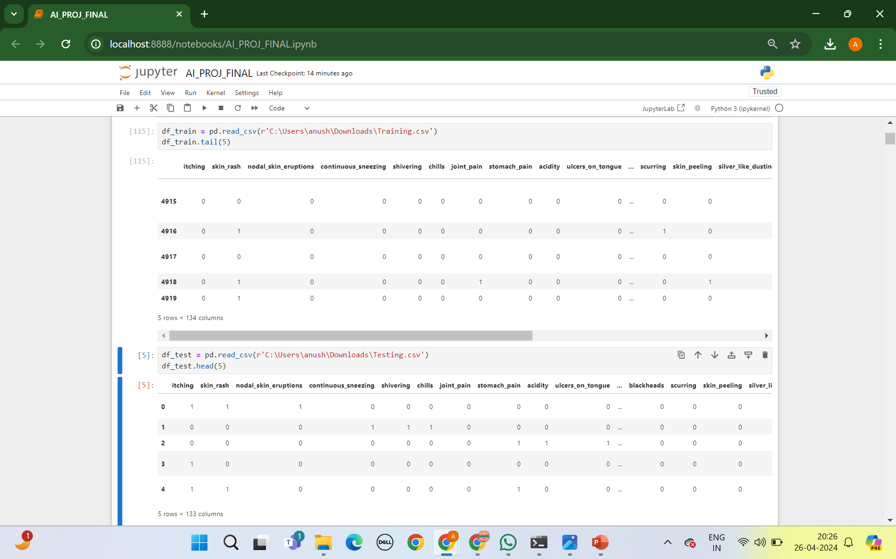
ABOUT DATASET
The dataset used in this project consists of anonymized patient records collected from healthcare institutions. It includes demographic information, medical history, laboratory test results, and diagnosed diseases. The dataset is sufficiently large and diverse to encompass a wide range of medical conditions, ensuring the robustness of the predictive model.

Slide 10
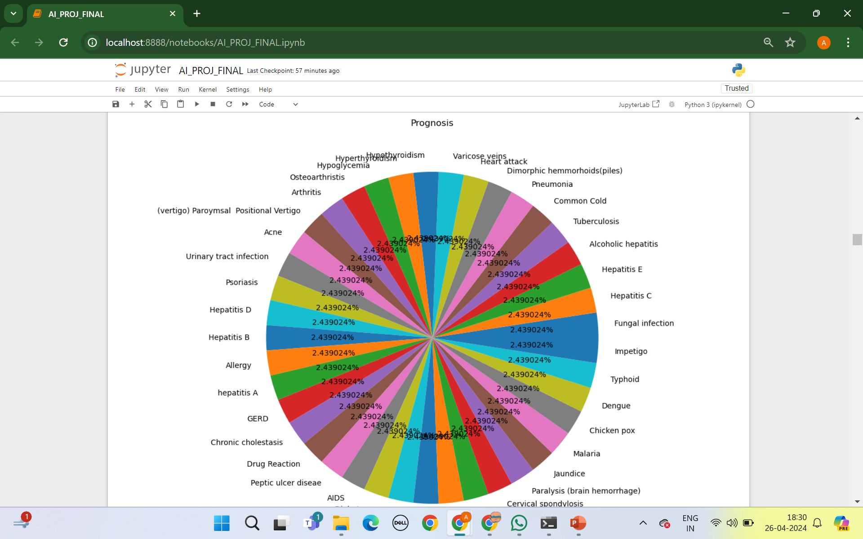
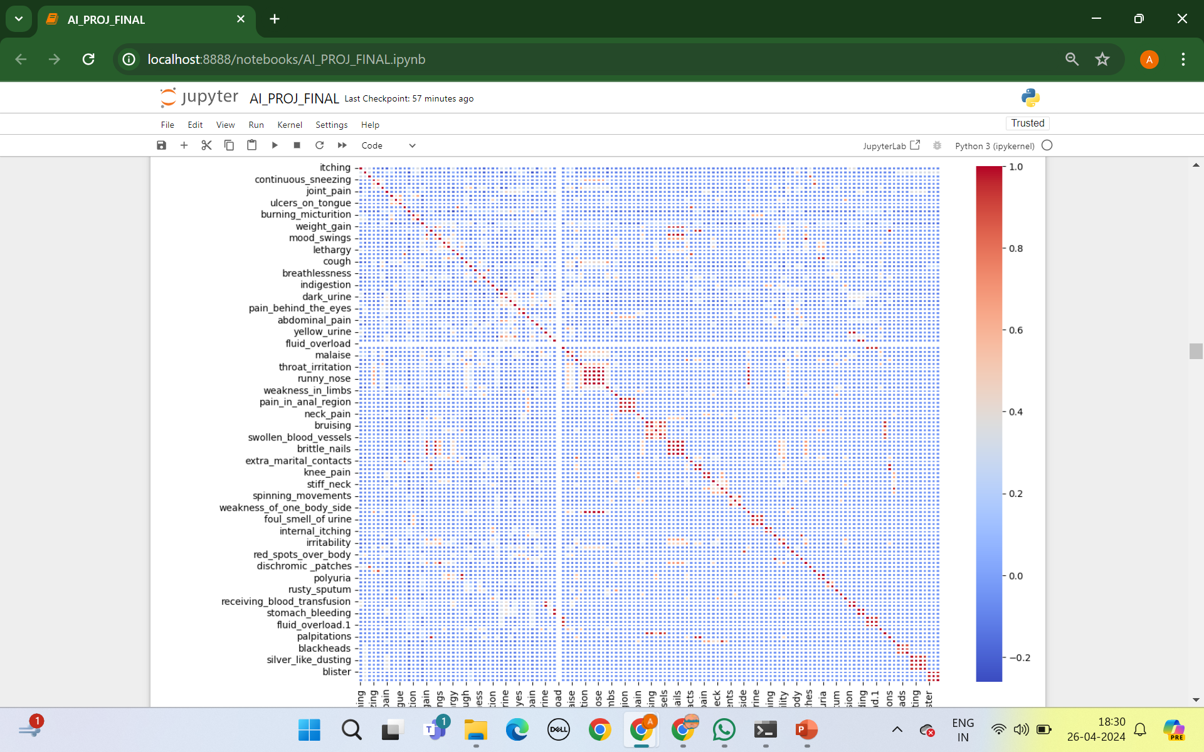
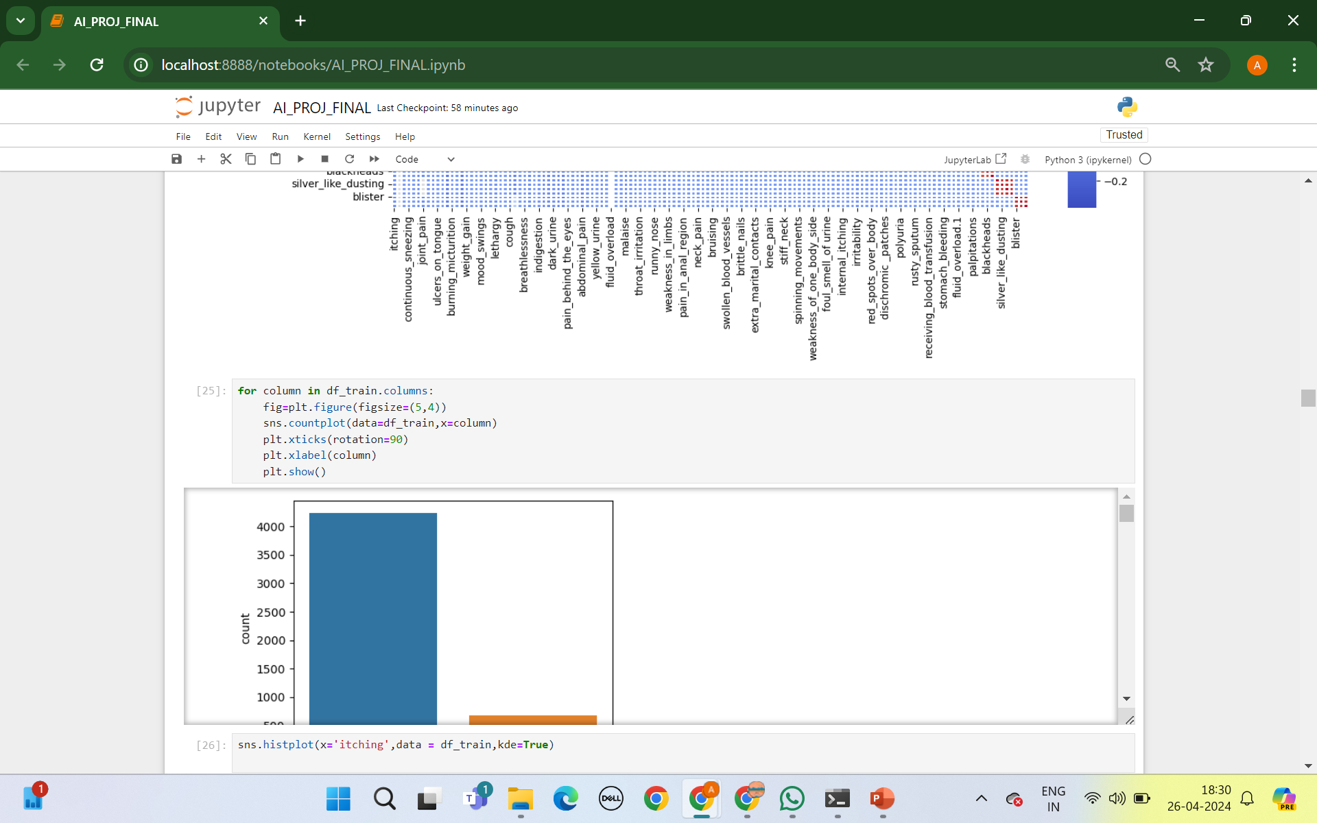
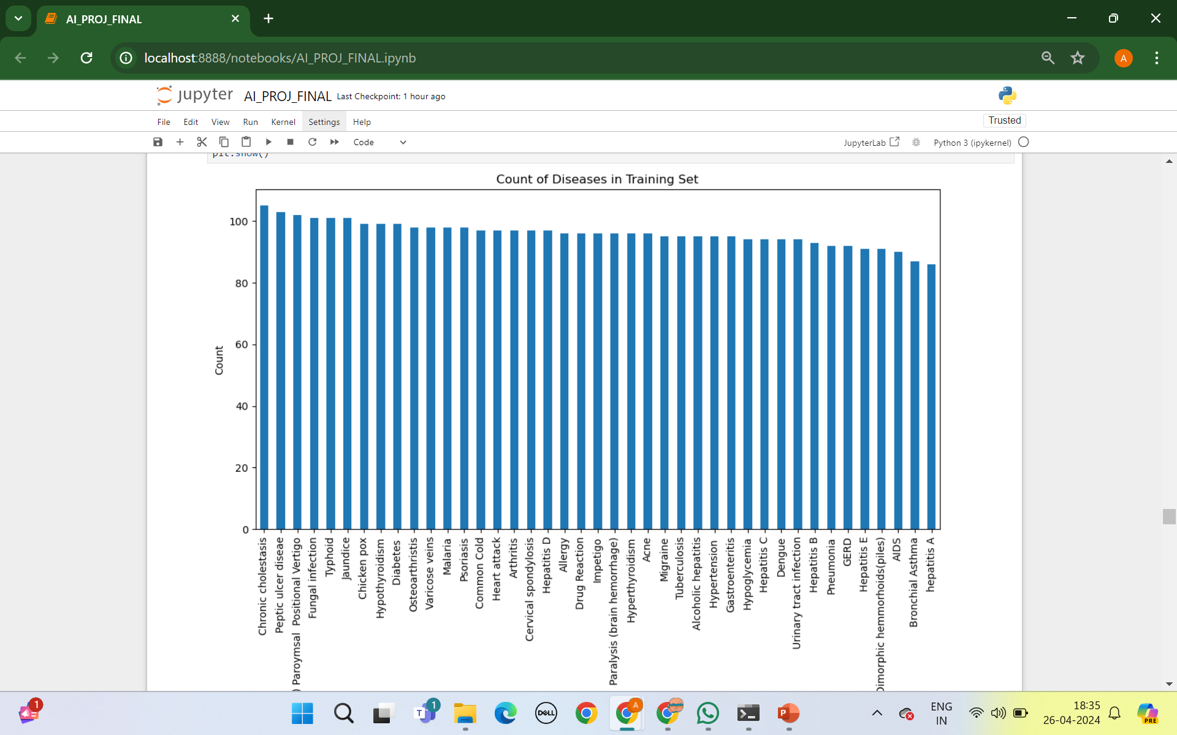

Slide 11
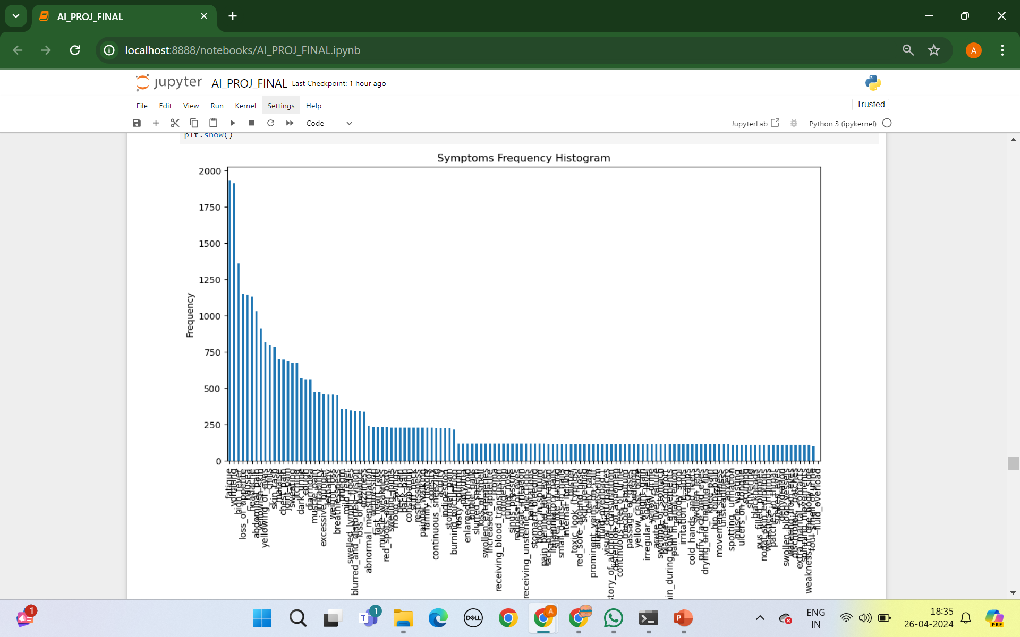
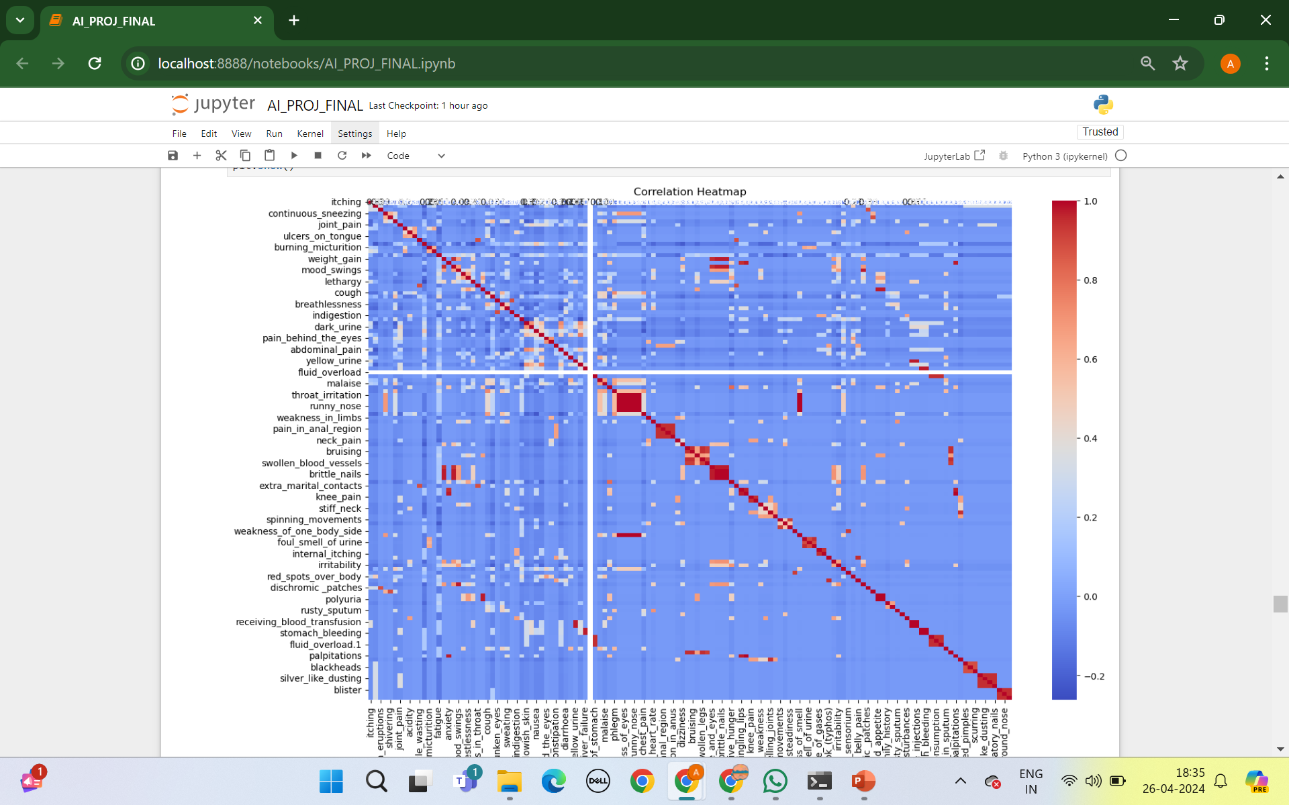
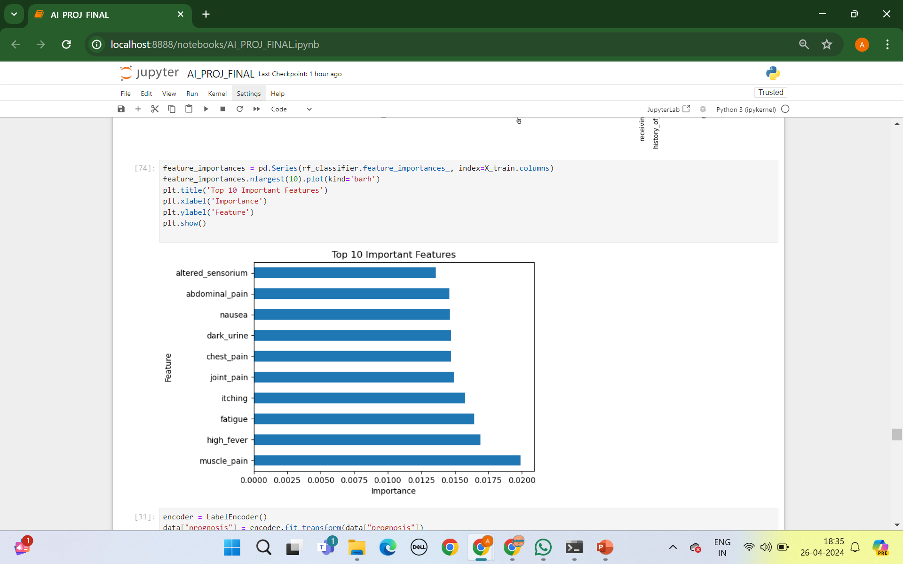

Slide 12
Recommendations:
By predicting diseases early, patients can receive timely treatment and care, leading to better health outcomes and potentially saving lives.
We can provide personalized medicines tailoring treatment plans based on individual patient characteristics and disease risks can lead to more effective and required interventions.
Develop a user-friendly interface for health care professionals to easily interpret and interact with predictive models.

Slide 13
CONCLUSION
Machine learning shows great promise in revolutionizing disease prediction and proactive healthcare. Advanced algorithms and rich datasets enable early identification of disease risks, leading to better patient outcomes.
Early detection and personalized intervention are crucial in reducing disease burden and saving lives. Continued research and implementation of machine learning-based models are essential for enhancing clinical decision-making and shaping the future of medicine.
Integration of machine learning technologies is key to achieving more efficient and effective healthcare delivery, ushering in a new era of preventive healthcare.

Slide 14
THANK YOU
ANUSHA KATAPALLY akata4@unh.newhaven.edu
KAVYA SREE MOKTALA
kmokt1@unh.newhaven.edu

